Slide 1
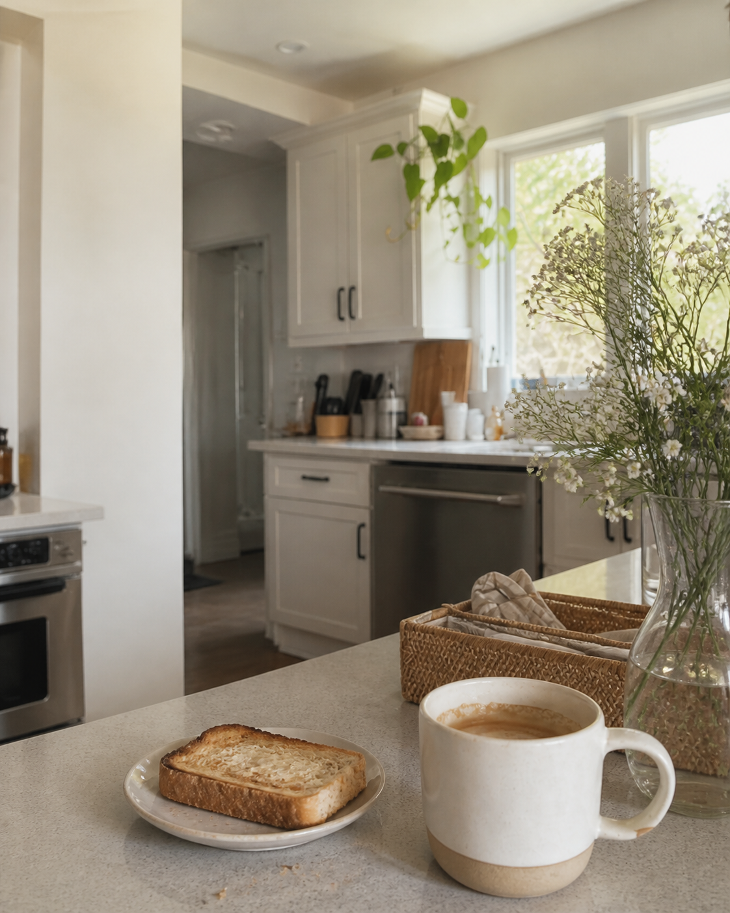
MORNING PAGES · 01
✿
♡
little morning
rituals
✦
✿
the first cup before the day asks anything of me
01 · lately

Slide 2
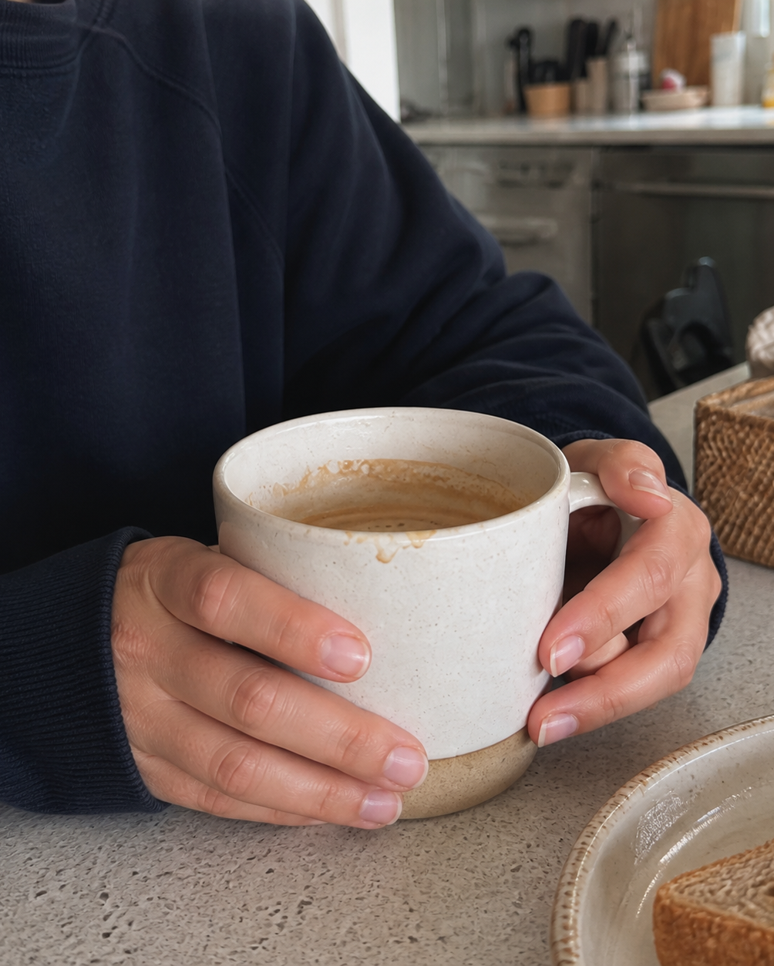
A SMALL ROUTINE · 02
✿
♡
toast, tea,
ten quiet minutes
✦
✿
before the emails and before the noise
02 · lately

Slide 3
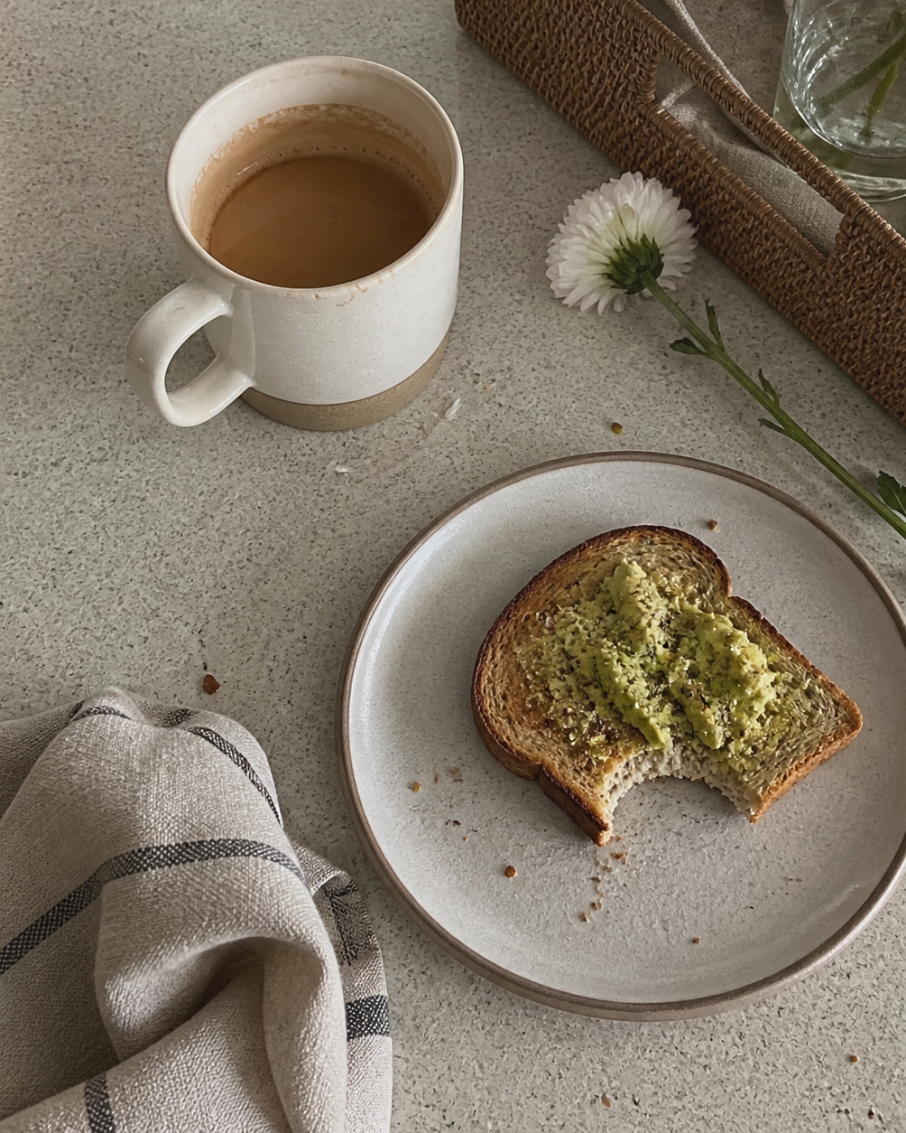
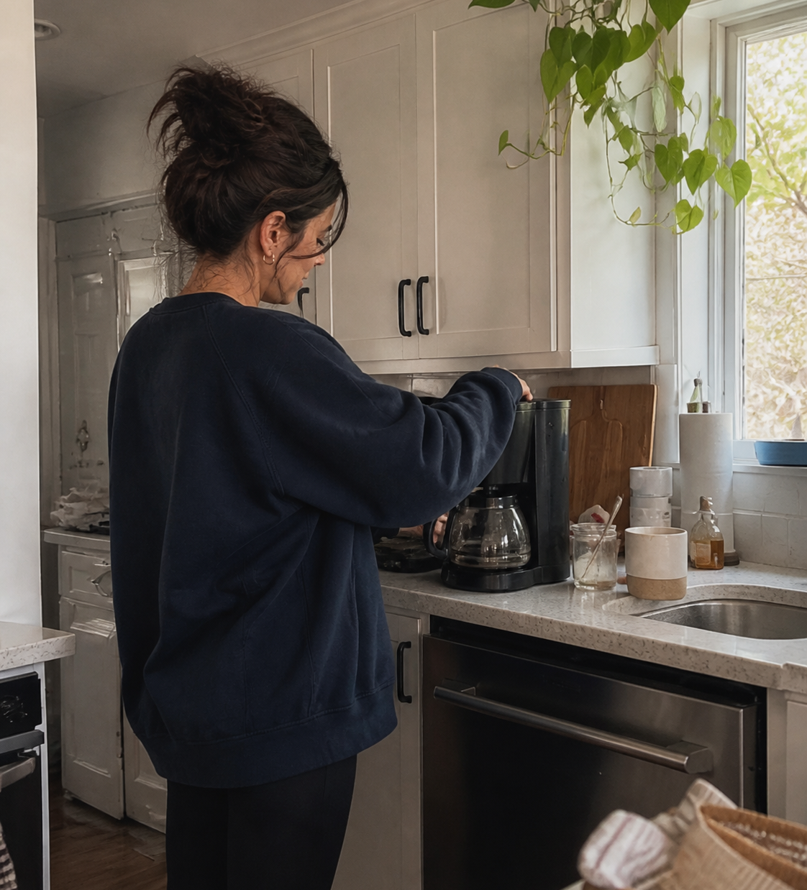
CURRENTLY · 03
✿
♡
the little
kitchen things
still warm
✦
✿
worth keeping
03 · lately

Slide 4

MICRO CELEBRATIONS · 04
✿
♡
first-hour
favourites
♡
a full mug
✦
♡
fresh fruit
✿
♡
no rushing
04 · lately

